Slide 1
Limitations of Vector Time
Data Structures Week 1
Large message sizes owing to the vector being piggybacked on each message.
The message overhead grows linearly with the number of processors in the system and when there are thousands of processors in the system, the message size becomes huge even if there are only a few events occurring in few processors.
Few techniques exist to reduce the overhead.
What can we do to reduce the load?

Slide 2
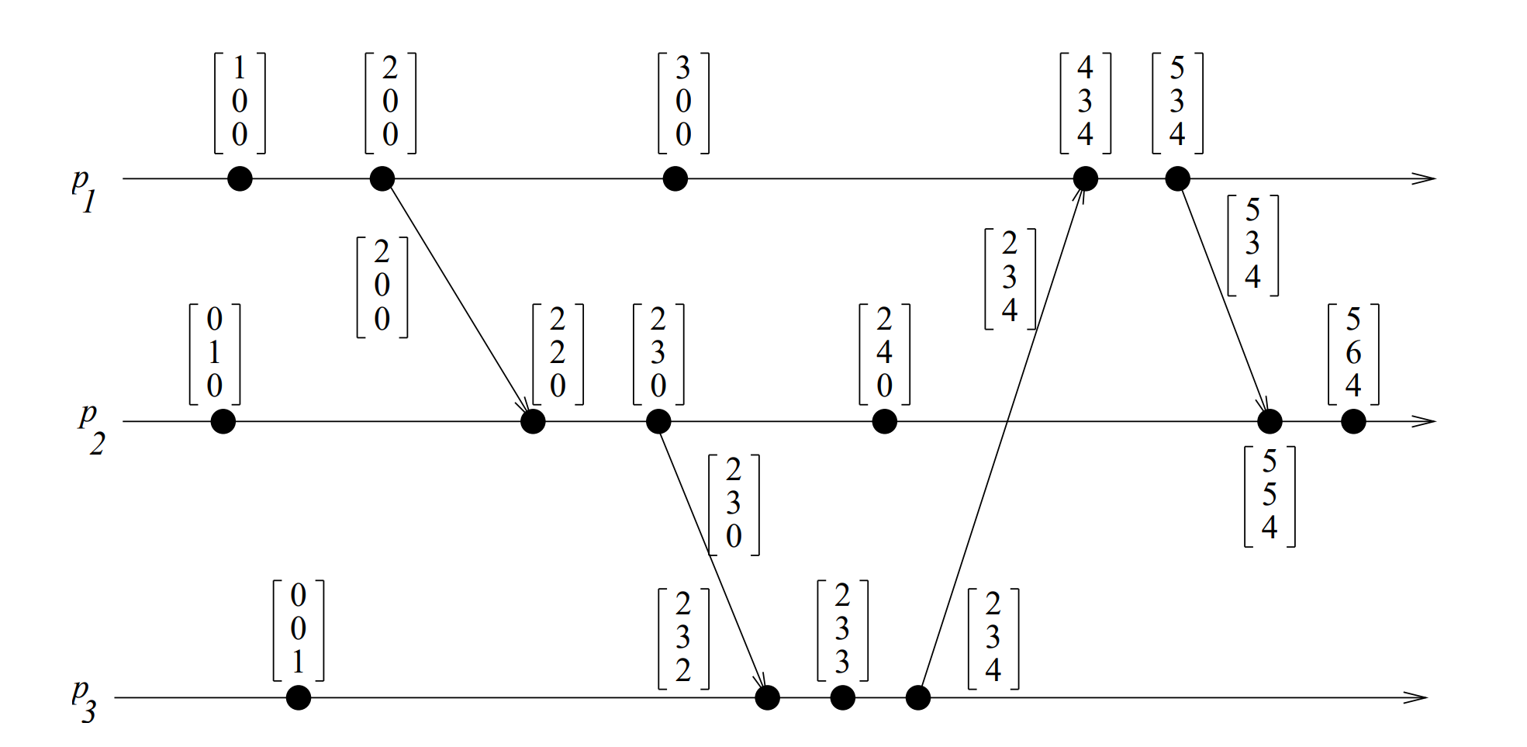
Vector Time – Example
Data Structures Week 1
Initially, a vector clock is [0, 0, 0, ...., 0]. d = 1.
Fill the timestamps for the other events.

Slide 3
Optimizations
Data Structures Week 1
Consider a message from P_{i} to P_{j}.
The message includes the vector time at P_{i}.
Of the n components of the vector time, only few would have changed since the last time P_{i} sent a message to P_{j}.
Need to include only those tuples.
  (i₁, t₁), (i₂, t₂), ...
Update rule changes slightly so that:
  P_{j} updates the component k of its vector time to max{vt_{j}[k], tk} where tk is the time reported by P_{i} with the tuple (k, tk)
Are we missing something?

Slide 4
Optimizations
Data Structures Week 1
Message sizes decrease in general, but local storage may increase.
  Need to know the vector time at P_{i} when the last message was sent to P_{j}, for each j.
  That is, each process stores the last msg sent to every other process.
  O(n²) storage per process.
A clever optimization can bring this storage to O(n) – Singhal kshemkalyanis technique

Slide 5
Singhal- Kshemkalyani Differential Technique
Data Structures Week 1
Process pi maintains the following two additional vectors:
◮LS_{i}[1..n] (‘Last Sent’) : Ls_{i}[j] indicates the value of vt_{i}[i] when process p_{i} last sent a message to process p_{j}.
◮LU_{i}[1..n] (‘Last Update’):LU_{i}[j] indicates the value of vt_{i}[i] when process p_{i} last updated the entry vt_{i}[j].
LU_{i}[i] =vt_{i}[i] ?
When do you update LS and LU ?
Can we put LS and LU together to know what is the information that needs to be piggybacked on the message ?

Slide 6
Singhal- Kshemkalyani Differential Technique
Data Structures Week 1
Process pi maintains the following two additional vectors:
◮LS_{i}[1..n] (‘Last Sent’) : Ls_{i}[j] indicates the value of vt_{i}[i] when process p_{i} last sent a message to process p_{j}.
◮LU_{i}[1..n] (‘Last Update’):LU_{i}[j] indicates the value of vt_{i}[i] when process p_{i} last updated the entry vt_{i}[j].
Clearly,LU_{i}[i] =vt_{i}[i] at all times
Lu_{i}[j] needs to be updated only when the receipt of a message causes p_{i} to update entry vt_{i}[j].
LS_{i}[j] needs to be updated only when p_{i} sends a message to p_{j}

Slide 7
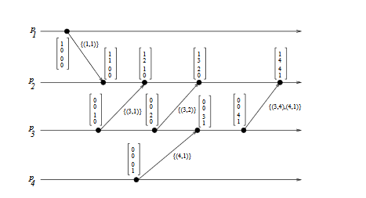
Data Structures Week 1

Slide 8
Singhal- Kshemkalyani Differential Technique
Data Structures Week 1
Since the last communication from pi to pj , only those elements of vector clock vt_{i}[k] have changed for which LS_{i}[j] < Lu_{i}[k] holds. Hence, only these elements need to be sent in a message from p_{i} to p_{j}.
When p_{i} sends a message to p_{j} , it sends only a set of tuples { (x,vt_{i}[x]) | LS_{i}[j] < LU_{i}[x] } as the vector timestamp to p_{j}, instead of sending a vector of n entries in a message.
Home Work !!
Will Singhal-Kshemkalyanis technique work if the messages
are not in FIFO order ?
Think about whether vector clocks can detect out of order msgs.
Notes:
Kshemkalyani works only for fifo order

Slide 9
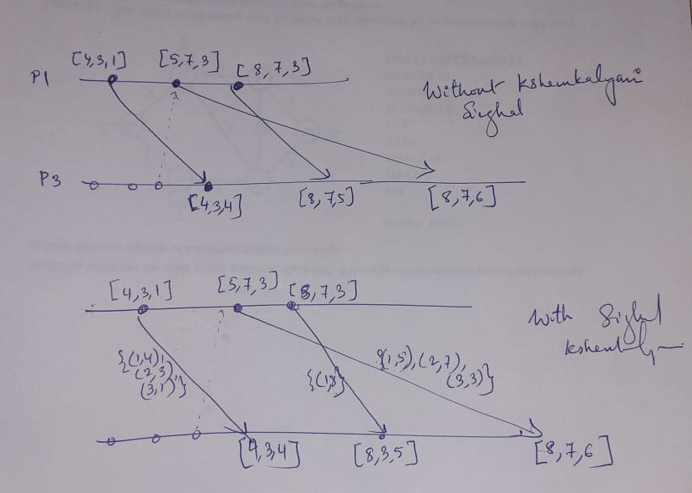
Singhal- Kshemkalyani Differential Technique – does not work for non fifo
Data Structures Week 1
Consider two send events of a process where between them no msgs were received. For such two events only the value Vi[i] would have changed. If these two sends are out of order, the receiving process will update its vector clock as below
Notes:
Kshemkalyani works only for fifo order-

Slide 10
A Distributed Program in Execution
  How can causal order among messages be guaranteed? Read about it from An Efficient Causal Order Algorithm for Message Delivery in Distributed System, Jangt, Park, Cho, and Yoon
  For causal ordering with broadcast check: Birman Schiper Stephensons Protocol to ensure causal ordering

Slide 11
Garbage Collection and Check Pointing
Data Structures Week 1
Want to know if a message I or some process has sent has reached everyone so that
-- I can remove it from my storage
-- Can be used for checkpointing

Slide 12
Teasers-1
Data Structures Week 1
Suppose I want to know whether an updation event at site D at time t which was propagated(broadcasted) to all sites has reached everyone.
Nodes need this information to determine when it is safe to discard/stabilize updates.
Can I decipher looking at B’s vector sent to me if B has received the msg from D?
Notes:
Note: I can also be process D itself

Slide 13
Teasers-1
Data Structures Week 1
Suppose B received a msg from C before it sent a msg to me then
B updates as
V_{B}[D]= max(V_{B}[D], V_{C}[D]).
Hence we do not know if V_{B}[D] is update from C or an update B already had from D.
Conclusion: I can not know about message delivered to a particular process

Slide 14
Teasers-2
Data Structures Week 1
Suppose I want to know whether an updation event at site D at time t which was propagated to all sites has reached everyone assuming causual order and no lost messages:
Consider the below:
B sends msg to me. Can I know if B received the msg from D?

Slide 15
Teasers-2
Data Structures Week 1
Yes
Suppose not, Let us assume that B got D’s news through C.
Now, that means there were two msgs with recipient as B. One Is the msg from D and another is a msg from C due to which VB[D]=VC[D].
Now by causual order if two msgs are intended for the same destination; then the one sent first should reach first.
Can the msg from C to B with D’s update be sent before D’s msg to B?
No as D had broadcast all its msgs. So C can be sending the update on D to B only after D sent a msg to B.
Hence D’s msg to B will reach first and the update could not have come through anyone else
Conclusion: I can know about message delivered to a particular process using causal order

Slide 16
Teasers-3
Data Structures Week 1
Once again consider causal order:
I want to know of D’s msg has reached everyone.
Instead of receiving a msg from everyone if I receive a msg from B such that V_{B}[x] >= t for all x then can I conclude that all have received the broadcast from D?

Slide 17
Teasers-3
Data Structures Week 1
Instead of receiving a msg from everyone if I receive a msg from B such that V_{B}[x] >= t for all x then can I conclude that all have received the broadcast from D?
No.
P might have progressed to t. Then sent a msg to B. Then received a msg from D. So V_{B}[P] >= t does not imply that P has heard from D.
Note: If P had received a msg from D and P sends a msg to B then by causal order B receives msg from D before msg from P.
However, If P has not received a msg from D and P sends a msg to P then it is not necessary that B receives msg from D before msg from P.
Conclusion: I can not know about message delivered to all processes even in causal order.

